Slide 1
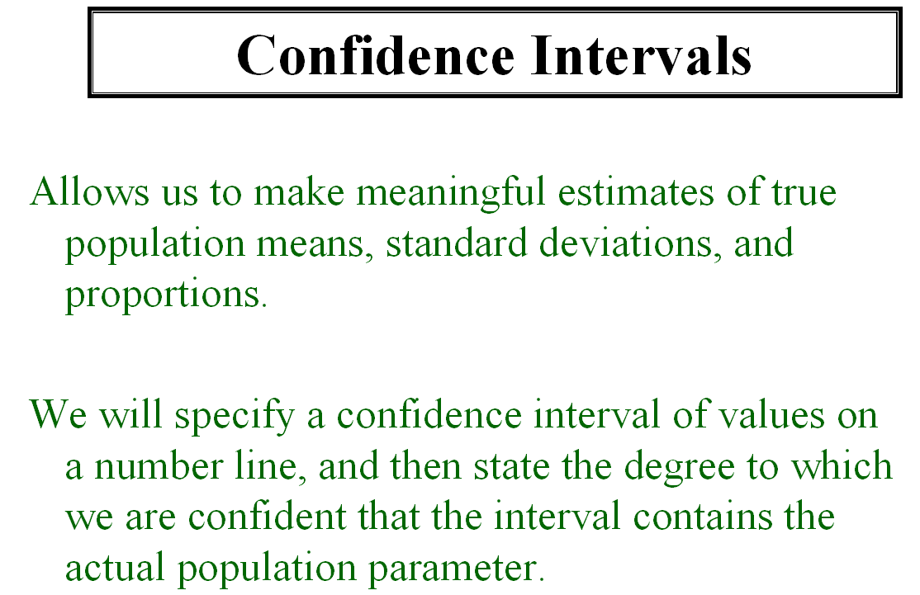

Slide 2
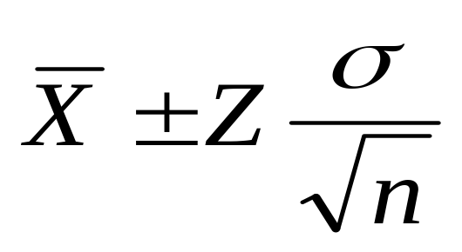
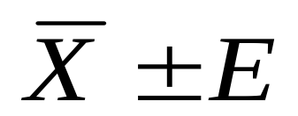
If the population standard deviation σ is known we use the Z distribution.
Where E is called:
The Margin of Error
The Maximum Error
The Maximum Error of the Estimate
The Maximum Allowable Error

Slide 3
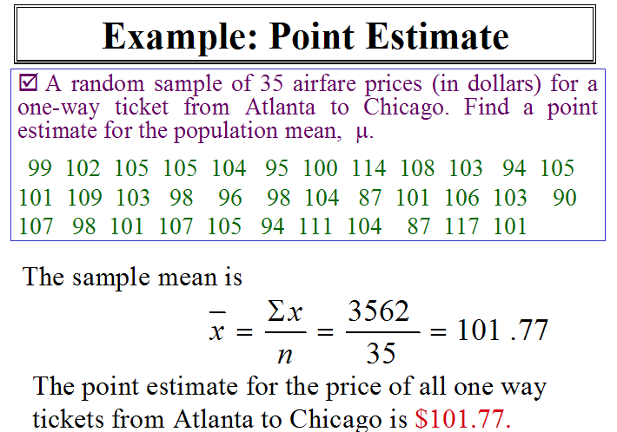

Slide 4
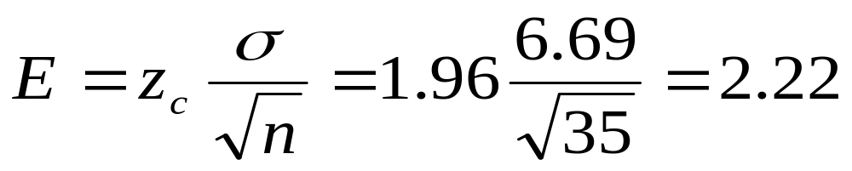
Maximum Error of Estimate
For a 95% confidence level, find the maximum error of estimate for the plane fare from Atlanta to Chicago.
Using z_{c}=1.96, σ = 6.69 and n = 35,
The maximum error of the estimate is $2.22
Notes:
The maximum error of estimate E is the greatest possible distance between the point estimate and the value of the parameter it is estimating for a given level of confidence, c.
When n ≥ 30, the sample standard deviation, s can be used for σ.

Slide 5
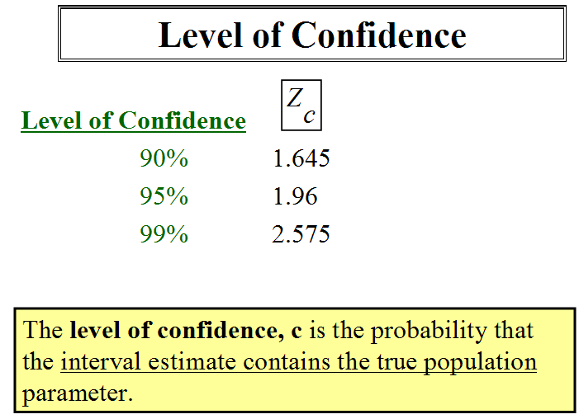

Slide 6
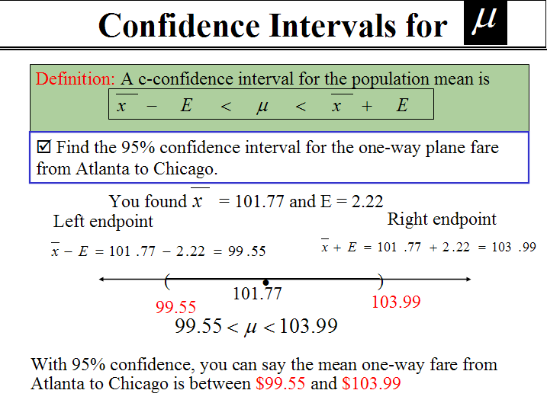

Slide 7
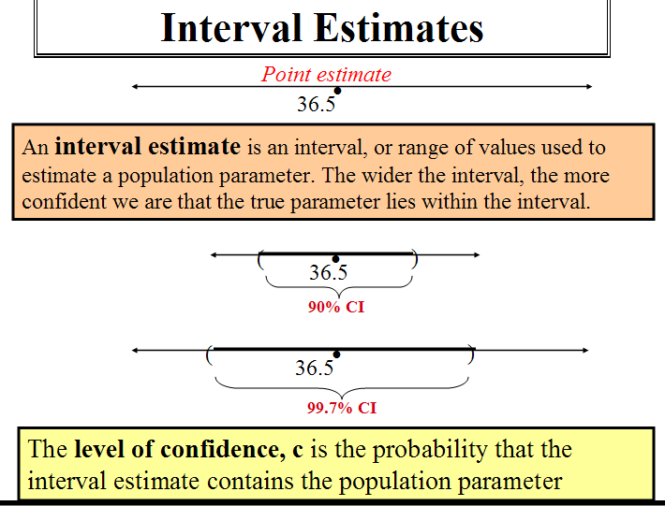

Slide 8
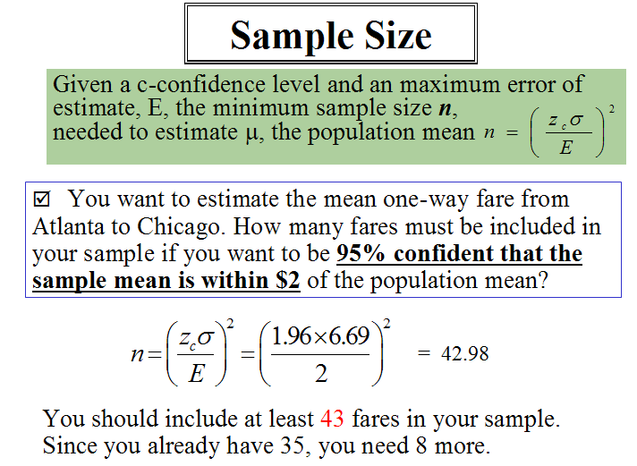

Slide 9
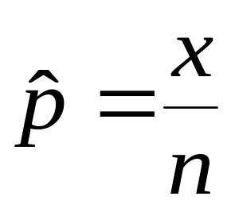
Sample Proportion
Proportion: The fraction, ratio, or percent of successes. There are only 2 possible outcomes, success or failure.

Slide 10
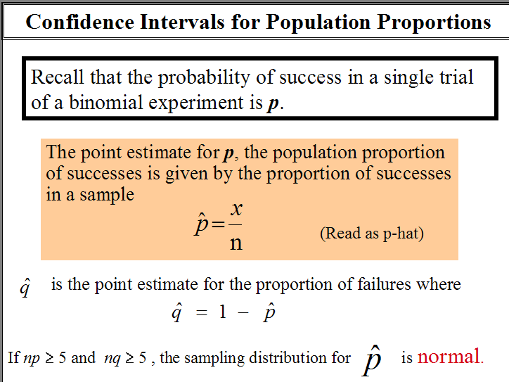

Slide 11
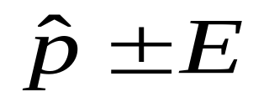
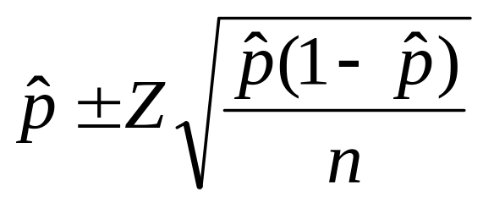
Confidence Interval for a Population Proportion
The confidence interval for a population proportion is estimated by:

Slide 12

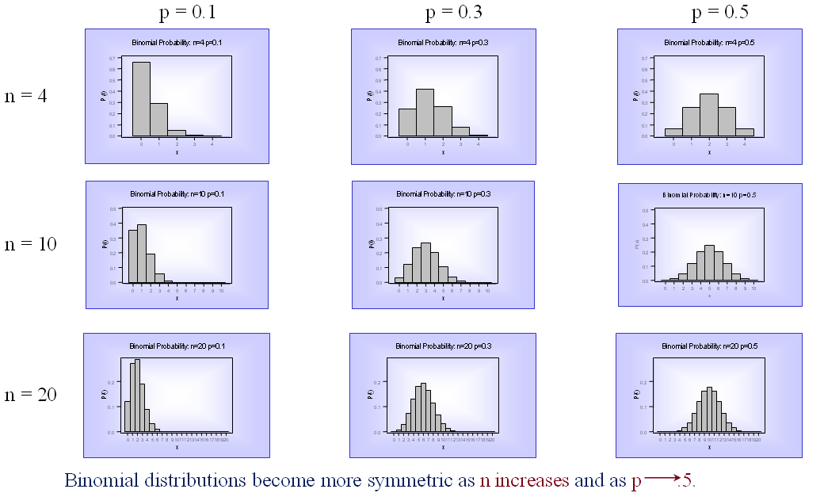
If np ≥ 5 and nq ≥ 5 , the sampling distribution for is normal.

Slide 13
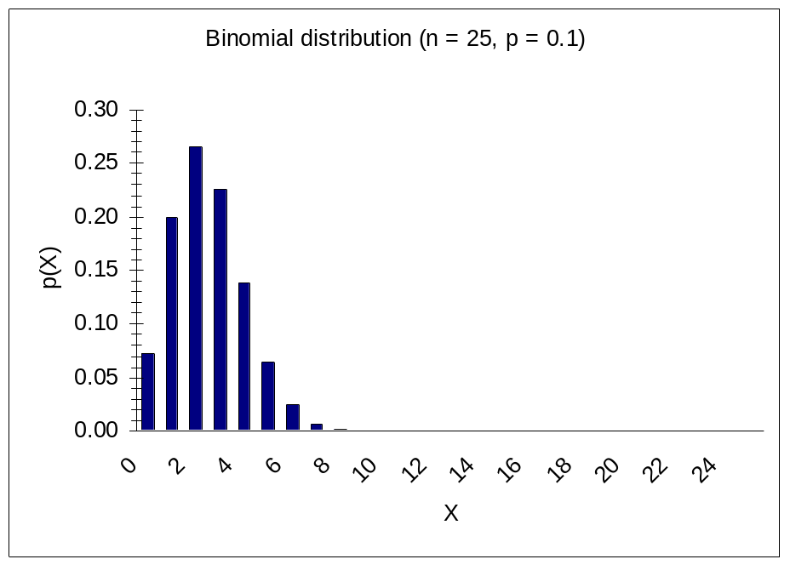
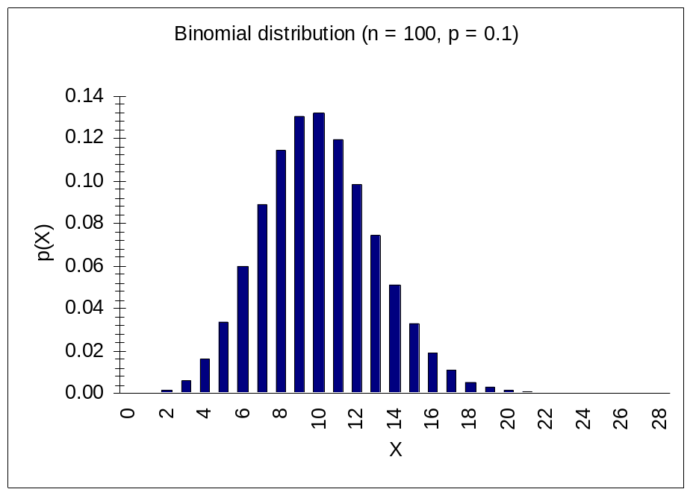
If np ≥ 5 and nq ≥ 5 , the sampling distribution for is normal.

Slide 14
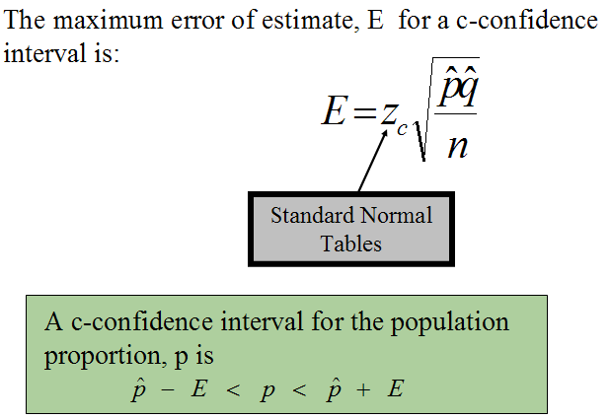

Slide 15
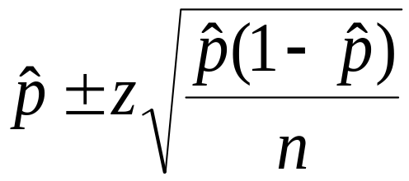
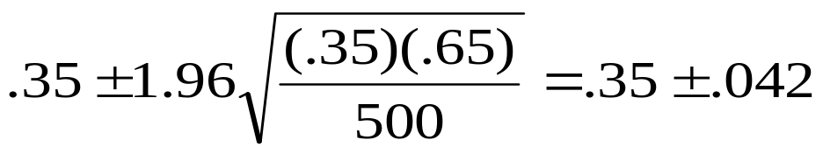
EXAMPLE 1
A sample of 500 executives revealed 175 planned to sell their homes and retire to Arizona. Develop a 95% confidence interval for the proportion of executives that plan to sell and move to Arizona.
There is a 95% probability that the confidence interval
(.308, .392) contains the true population parameter.

Slide 16
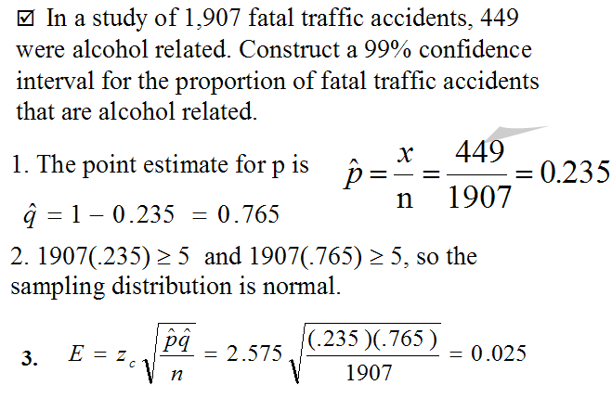
EXAMPLE 2

Slide 17
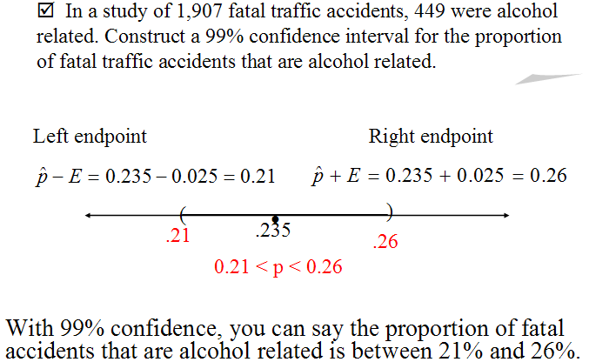

Slide 18
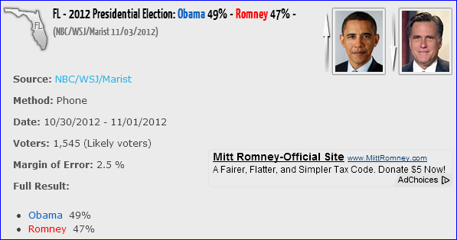
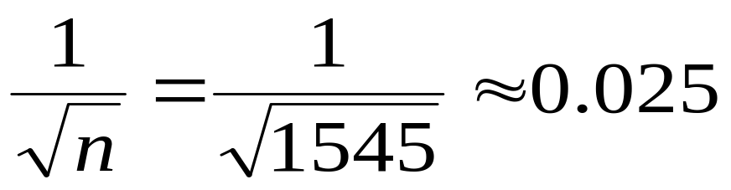
Approximating the Margin of Error

Slide 19
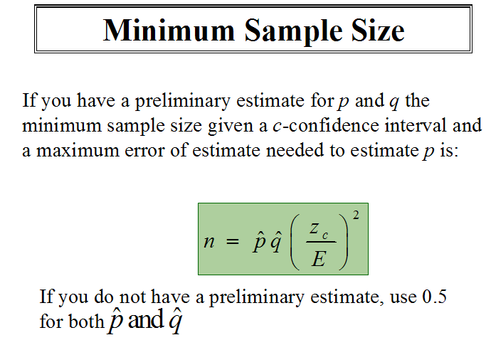

Slide 20
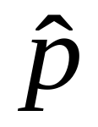

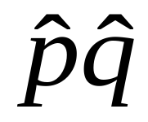
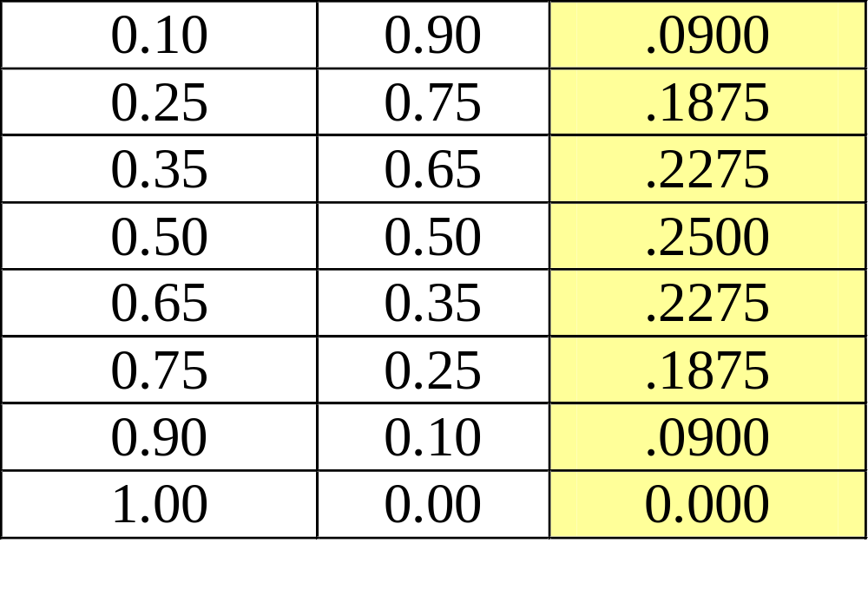
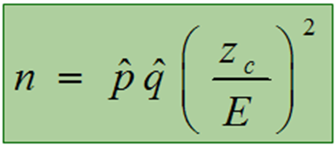

Slide 21
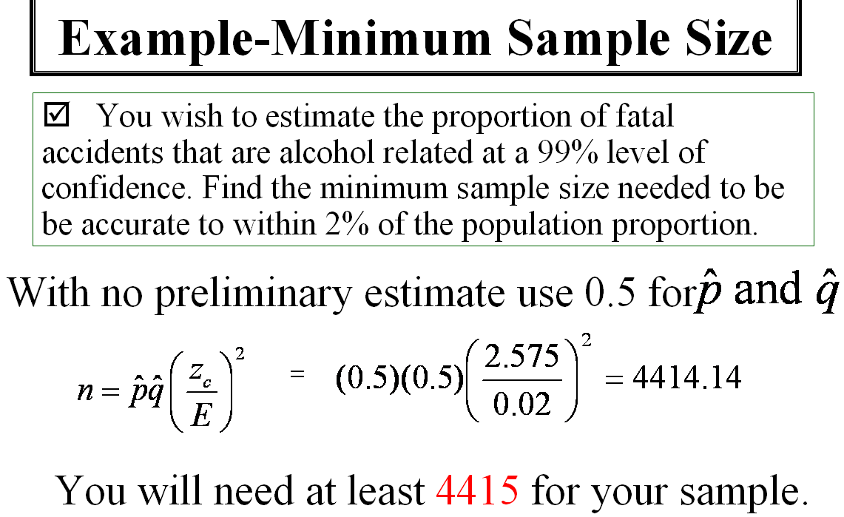

Slide 22
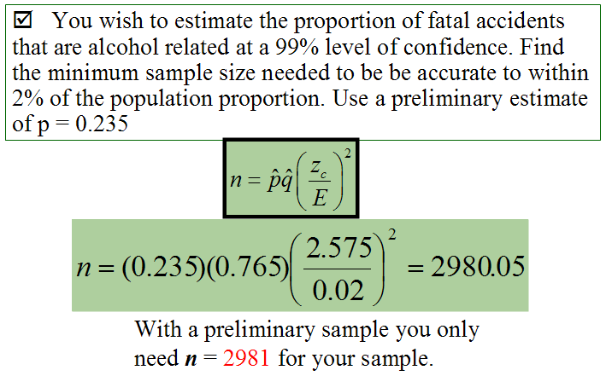

Slide 23
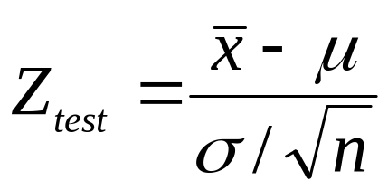
Hypothesis Testing
Hypothesis Test - A process that uses sample statistics to test a statement about the value of a population parameter.
Test Statistic - The statistic that is compared to the parameter.

Slide 24




Hypothesis Testing - Example
Suppose a battery manufacturer comes out with a claim that the mean life of its new AA battery is 300 minutes. You work for a consumer protection agency and decide to test this claim. You randomly sample 100 batteries and find that the mean life is only 294 minutes. The standard deviation is 20 minutes.

Slide 25
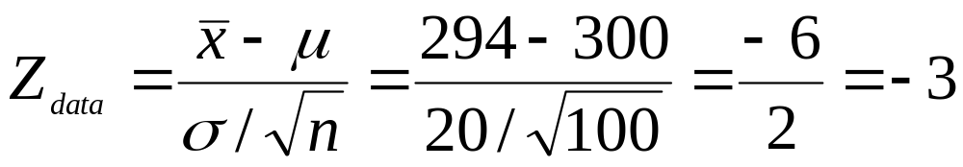
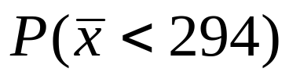

Hypothesis Testing - Example
Suppose a battery manufacturer comes out with a claim that the average life of its new AA battery is 300 minutes. You work for a consumer protection agency and decide to test this claim. You randomly sample 100 batteries and find that the mean life is only 294 minutes. The standard deviation is 20 minutes.
P-Value - The probability of obtaining a sample statistic with a value as extreme as the sample data, or even more extreme.

Slide 26
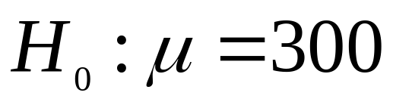

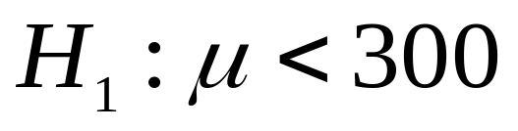

Left-tail test
H₁: μ < 300
The probability of getting a mean sample
this extreme – or more extreme - is only 0.0013.

Slide 27
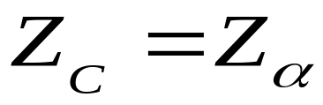

Critical Value
Rejection Region
(critical region)

Slide 28
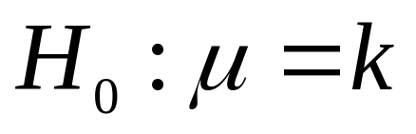
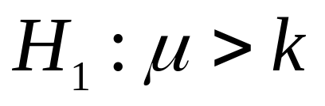
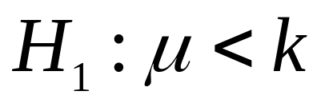
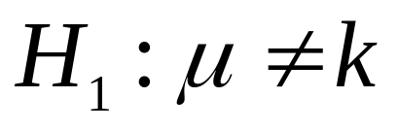
Examples of Claims and Their Complement
One-Tailed Test
One-Tailed Test
Two-Tailed Test
Right-Tailed Test
Left-Tailed Test

Slide 29
The Level of Significance α
The decision about whether there is enough
evidence to reject the null hypothesis can be
made by comparing the P-value to the value of α (the level of significance of the test).
If P < α reject the null hypothesis
If P > α fail to reject the null hypothesis

Slide 30

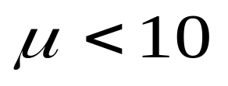
Writing Hypothesis
Write the alternative hypothesis first.
A hospital states that its average ambulance response time is less than 10 minutes.
H₀ :
H_{a} :
min
claim
Notes:
When we perform a hypothesis test, we make one of only 2 decisions:
1.) Reject the null hypothesis.
2.) Accept the null hypothesis.

Slide 31






Hypothesis Testing - Example
A real estate agent states that the average price for homes in a certain subdivision is $150,000. You believe that the average price is lower. If you plan to test this statement by taking a random sample of the prices of the homes in the subdivision, what would the formulated set of hypothesis will be?
Suppose:

Slide 32
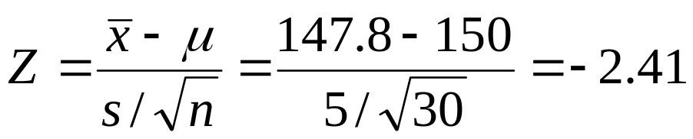

p = 0.008
z = -2.41
Reject the Null
Hypothesis

Slide 33
Hypothesis Testing - Example
A real estate agent claims that the average price for homes in a certain subdivision is $150,000. You don’t trust real estate agents and are skeptical of everything they say. If you plan to test this statement by taking a random sample of the prices of the homes in the subdivision, what would the formulated set of hypothesis will be?

Slide 34
Hypothesis Testing - Example
A real estate agent claims that the average price for homes in a certain subdivision is $150,000. You don’t trust real estate agents and are skeptical of everything they say. If you plan to test this statement by taking a random sample of the prices of the homes in the subdivision, what would the formulated set of hypothesis will be?
Suppose:

Slide 35

p = 0.008
z = -2.41
Reject the Null
Hypothesis
z = -2.41
z = +2.41
p = 0.008 + 0.008 = 0.016
Do Not Reject the Null Hypothesis
Notes:
Because the critical z = -2.33 for the left tailed and +/- 2.575 for the two tailed, we reject the null hypothesis for the left tailed only.
Also, if our test statistic revealed an average price of $152,400, we would reject the null hypothesis that mu = 150,000 and have no useful information. In this situation, the left tailed test would not reject the null hypothesis.
At z = -2.41 the area is 0.0080.

Slide 36
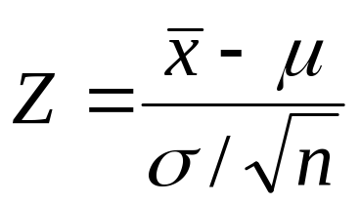
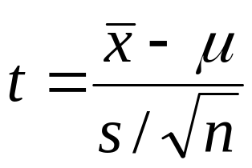
Hypothesis Testing for Small Samples
When σ is unknown and the sample size is small, we use t instead of Z.
Test Statistic - The statistic that is compared to the parameter in the null hypothesis.

